Slide 1
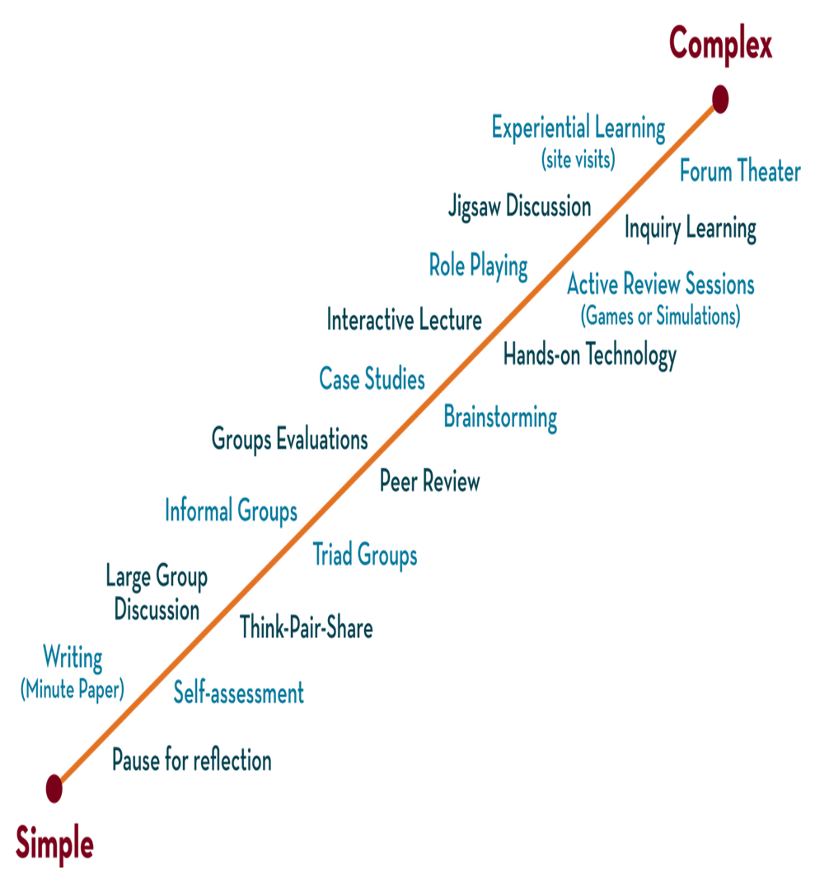

Department of CSE
DESIGN AND ANALYSIS OF ALGORITHMS
24CS2203
Topic:
String Matching
Session - 6

Slide 2





AIM OF THE SESSION
To familiarize students with the concept of Dynamic Programming.
INSTRUCTIONAL OBJECTIVES
This Session is designed to:
Demonstrate :- Dynamic programming and its elements.
Describe :- Steps that the dynamic programming follows.
LEARNING OUTCOMES
At the end of this session, you should be able to:
Define :- Dynamic programming and its elements.
Describe :- Principles of optimality
Summarize:- top-down and bottom-up approaches of dynamic programming.

Slide 3
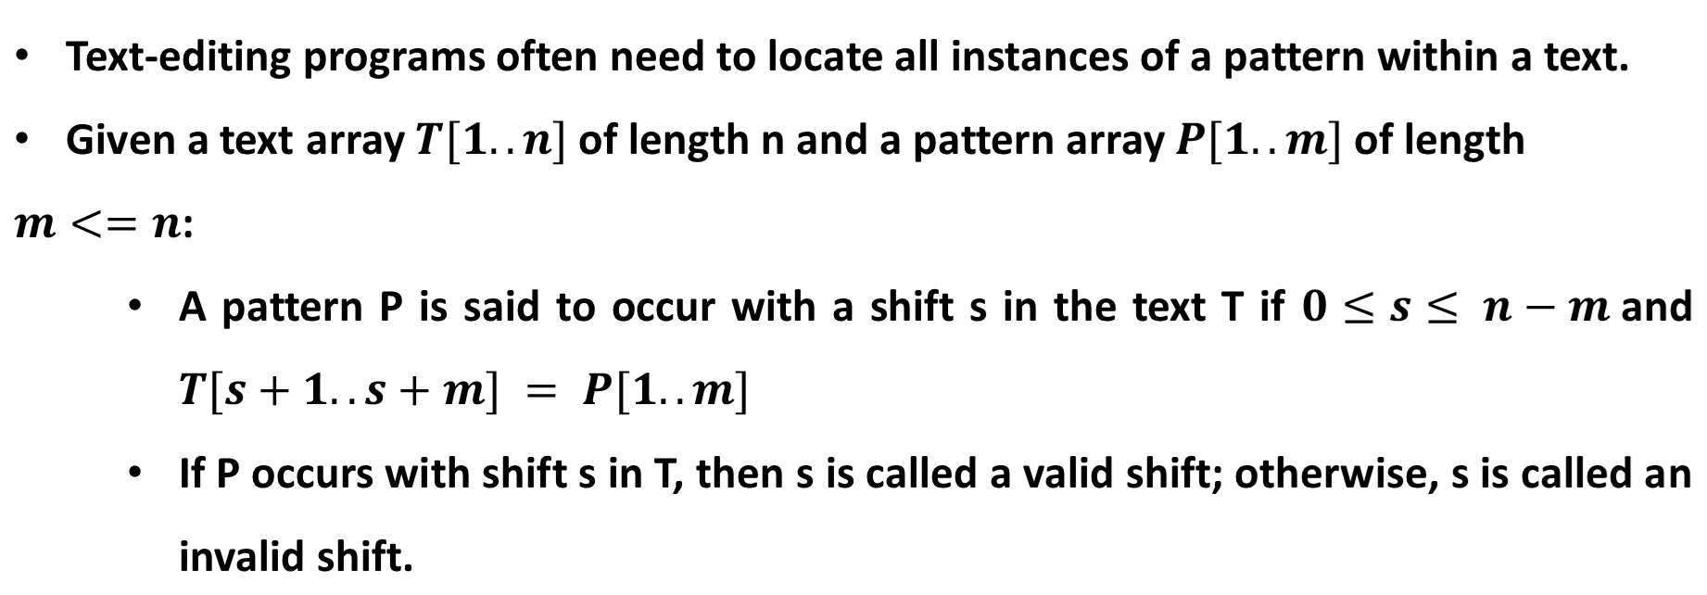
String Matching

Slide 4
String Matching
The string-matching problem involves identifying all valid shifts where a given pattern P appears within a given text T.
Example:
Given T = text{ababcabdabcaabc} and P = text{abc}:
The first occurrence starts at T[3]
The second occurrence starts at T[9]
The third occurrence starts at T[13]

Slide 5
Applications
Searching keywords in a file
Searching engines (like Google and Openfind)
Database searching (GenBank)

Slide 6
Types of algorithms
Naive String-matching algorithm
Rabin-Krap algorithm
Knuth–Morris–Pratt algorithm
Finite automata
Horspool algorithm
Boyer Moore algorithm
Preprocess the pattern to get some information about it, store this information in a table, and then use this information during an actual search for the pattern in a given text.
Input enhancement

Slide 7
Steps to be followed
Analyze the concept of each technique for string matching
Design an algorithm
Compute the time complexity

Slide 8
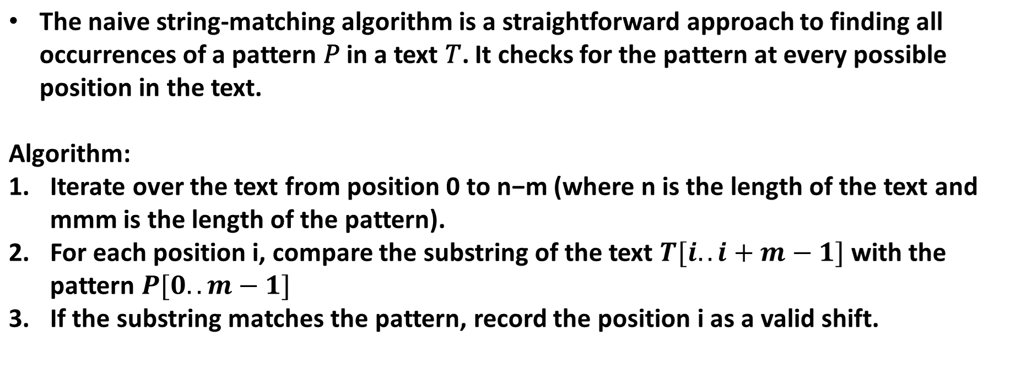
Naive String matching

Slide 9
Example
Text: a b c d a b f a b e g; Pattern: abe
Text | a b c d a b f a b e g | No of comparisons
1st iteration | a b e | 3
2nd | a b e | 1
3rd | a b e | 1
4th | a b e | 1
5th | a b e | 3
6th | a b e | 1
7th | a b e | 1
8th | a b e | 3
Result in 8th iteration and the number of comparisons are 14

Slide 10
Example
Let's go through an example with T=ababcabdabcaabc and P=abc.
Text: ababcabdabcaabc
Pattern: abc
The algorithm checks for the pattern at every position in the text:
At position 0: T[0..2] = aba (no match)
At position 1: T[1..3] = bab (no match)
At position 2: T[2..4] = abc (match found, index 2)
At position 3: T[3..5] = bca (no match)
At position 4: T[4..6] = cab (no match)
At position 5: T[5..7] = abd (no match)
At position 6: T[6..8] = bda (no match)
At position 7: T[7..9] = dab (no match)
At position 8: T[8..10] = abc (match found, index 8)
At position 9: T[9..11] = bca (no match)
At position 10: T[10..12] = caa (no match)
At position 11: T[11..13] = aab (no match)
At position 12: T[12..14] = abc (match found, index 12)
The matches are found in indices 2, 8, and 12.

Slide 11
Algorithm
Input: text (T) and pattern (P)
Output: pattern found or not
Naïve_String_alg(T,P):
n=text_length
m=pattern_length
for s=0 to n-m or s=1 to (n-m+1)
if P[1..m]=T[s+1..s+m]
return found
Time complexity => (n-m+1) (m)
=> O(nm)
Text: a b c d
Patt: x y
n=4
m=2
(n-m) =2 which means s= 0 to 2
or
(n-m+1)=3 which means s= 1 to 3

Slide 12
Cases
Best case:
If you find the pattern at the starting of the text
Example:
Text: abcdabdef
Patt:ab --------2 comparisons
O(m)

Slide 13
Cases
Worst case:
Text: a b c d e f g h
Patt: f g h
6th iteration
Number of comparisons =8
Worst case:
Text: a a a a a a a b
Patt: a a b
NOTE:
N and m are the same in both cases. We find the pattern in the end and in each iteration where we made ‘m’ comparisons is the worst case.
O(n-m+1)(m) => O(nm)

Slide 14
Examples
Text: A A B A A C A A D A A B C A B A
Patt: A A B C
10 iterations and 23 comp
Text: HELLO HOW ARE YOU
Patt: ARE

Slide 15
Advantages
The comparison of the pattern with the given string can be done in any order
There is no extra space required
The most important thing is that it doesn’t require the pre-processing phase, as the running time is equal to the matching time

Slide 16
Disadvantages
There is only one disadvantage of the naïve string matching approach, that it is inefficient.
This is because when it has found a position, it does not use it again to find the other position. It goes back to the starting point and looks for the pattern over again.
And so, it does not use the information from the previous shift again

Slide 17
Rabin –Karp algorithm
The Rabin-Karp algorithm matches the hash value of the pattern with the hash value of the current substring of the text.
If the hash values match, it then starts matching individual characters.
The Rabin-Karp algorithm needs to calculate the hash values for the following strings:
1. The pattern itself.
2. All the substrings of the text of length m, where m is the length of the pattern.

Slide 18
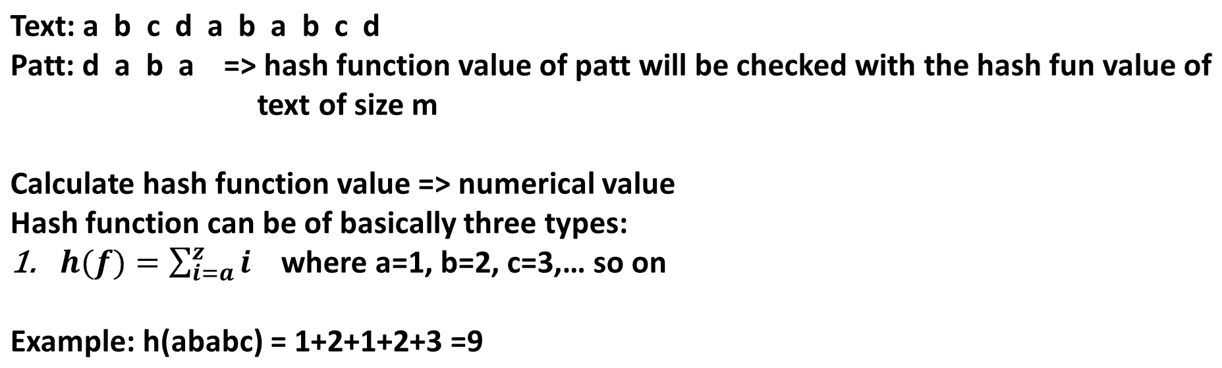
Concept

Slide 19
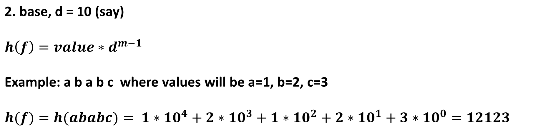
Concept

Slide 20
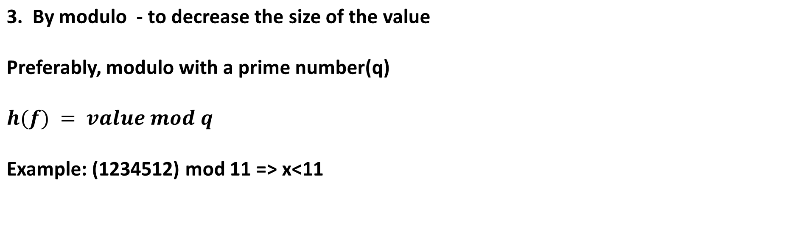
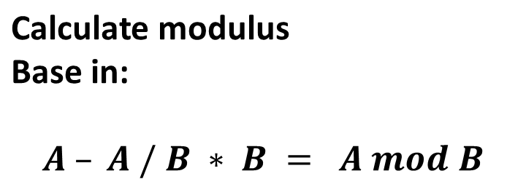
Concept

Slide 21
Algorithm
Step 1: Calculate the hash value of patten
Step 2: Then we calculate substring (m) consecutive hash values
if h(P) = h(substring)
then we compare pattern

Slide 22
Example
Text: a b b c a a c a Patt: a c a
Notes:
SPURIOUS HIT

Slide 23
Example
Text: a b b c a a c a Patt: a c a d=10

Slide 24
Example
Text: a b b c a a c a Patt: a c a d=10
To reduce the time complexity of the above method:
This formula is used for designing the algorithm.
1
)
]

Slide 25
Example
Given T = 31415926535 and P = 26
We choose q = 11
P mod q = 26 mod 11 = 4
3
1
4
1
5
9
2
6
5
3
5
31 mod 11 = 9 not equal to 4
3
1
4
1
5
9
2
6
5
3
5
14 mod 11 = 3 not equal to 4
3
1
4
1
5
9
2
6
5
3
5
41 mod 11 = 8 not equal to 4
Notes:
Here, we are using a window of size 2. It corresponds to the length of the pattern. For the first window, we see that the value is 31. If we wanted to find out the value of the next window, we would merely subtract the high-order digit 3 and add the low-order digit 4, so that we are left with 14, the value of the second window.

Slide 26
Example cont
3
1
4
1
5
9
2
6
5
3
5
15 mod 11 = 4 equal to 4 -> spurious hit
3
1
4
1
5
9
2
6
5
3
5
59 mod 11 = 4 equal to 4 -> spurious hit
3
1
4
1
5
9
2
6
5
3
5
92 mod 11 = 4 equal to 4 -> spurious hit
3
1
4
1
5
9
2
6
5
3
5
26 mod 11 = 4 equal to 4 -> an exact match!!
3
1
4
1
5
9
2
6
5
3
5
65 mod 11 = 10 not equal to 4
Notes:
Spurious hit is when we have a match but it isn’t an actual match to the pattern. When this happen, further testing is done.

Slide 27
Example cont
3
1
4
1
5
9
2
6
5
3
5
53 mod 11 = 9 not equal to 4
3
1
4
1
5
9
2
6
5
3
5
35 mod 11 = 2 not equal to 4
As we can see, when a match is found, further testing is done to ensure that a game has indeed been found.

Slide 28
Complexity
Best and Average Case:
  O(n+m), where n is the length of the text and m is the length of the pattern.
  Efficient due to hash comparisons.
Worst Case:
  O(nm) if hash collisions occur frequently, leading to direct substring comparisons.

Slide 29
Applications
Searching for substrings in large texts.
Plagiarism detection.
Bioinformatics (e.g., searching DNA sequences).
Database querying for strings.

Slide 30
Summary
Average Case Time Complexity: O(n+m)
Worst Case Time Complexity: O(n⋅m) (due to hash collisions and character comparisons).
Space Complexity: O(1)

